Slide 1
Comprehensive Database for Facial Expression Analysis
Paper by Kanade, Cohn & Tian (2000)
Presented by Ikhlas Idris Ismail Mohammad Ali Hibtullaji Abdul Ali Amarji Attarwala

Slide 2
Agenda
History prior & paper review
Related work & databases
Activity!
Questions?

Slide 3
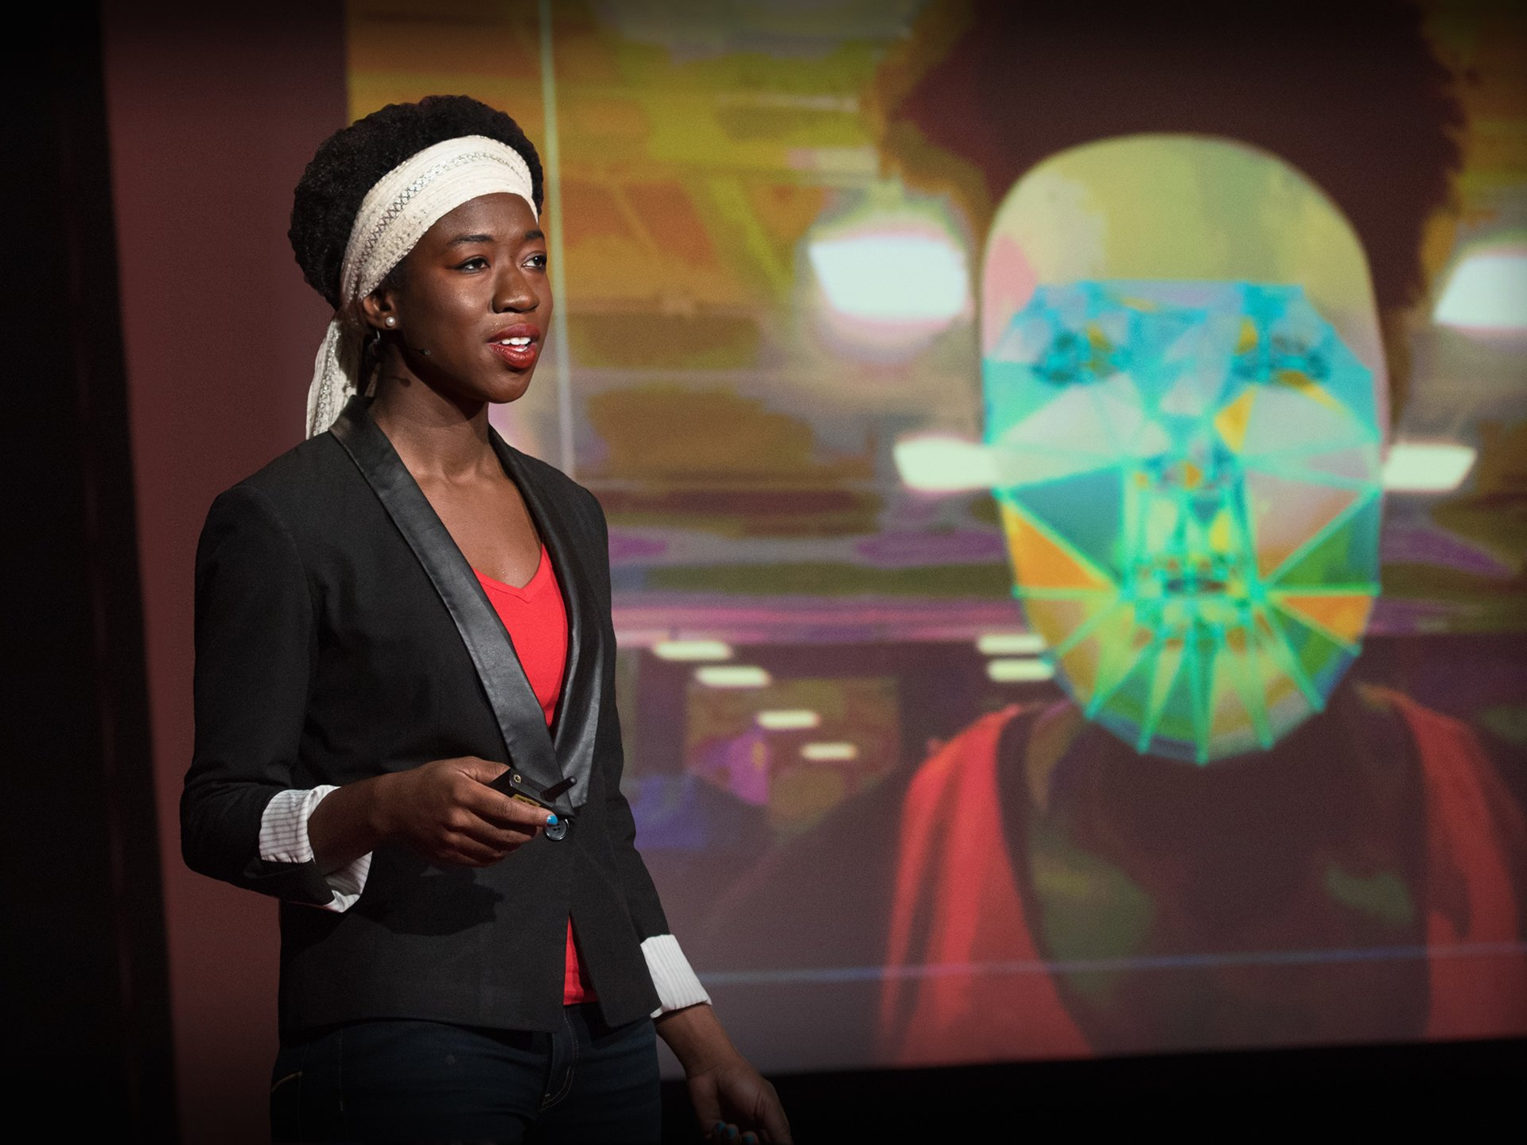
History Prior
There was development in facial feature tracking, but also...
Lack of comprehensive database:
Only global expressions considered
Little diversity between subjects (age/ethnicity)
No common datasets for comparative tests
Joy Buolamwini's "How I'm Fighting Bias In Algorithms"

Slide 4
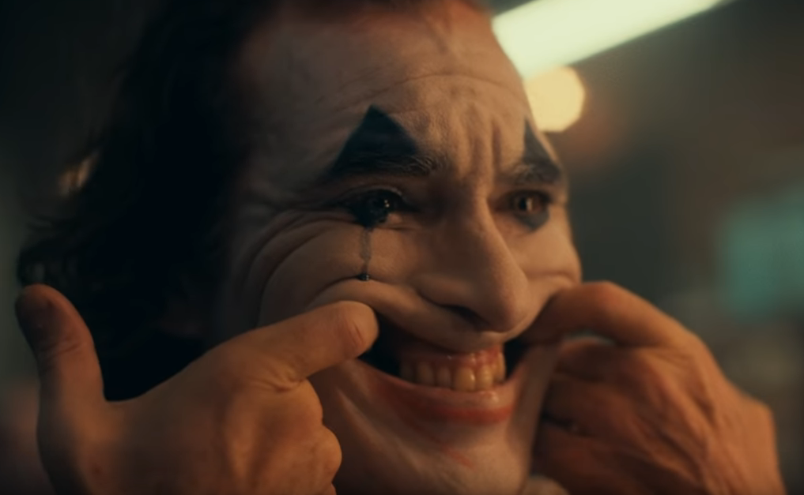
History Prior (cont…)
Problem space
Covered a small set of expressions, and no fine/subtle changes
Solution: FACS, taxonomizing facial movements
Note the difference between:
FACS … vs … EMFACS
ex. Fear = 1 + 2 + 4 + 5 + 7 + 20 + 26
FACS … vs … F.A.C.E.S
Previous claim of expression transition requiring neutral states
Required dynamic combinations of action units!!
Subjects asked to pose (deliberate vs. spontaneous expressions)
Facial Action Coding System
Notes:
FACS = Visually discern facial movement based on anatomical

Slide 5
History Prior (cont…)
Problem space
Reliability of labeling data
Head orientation & scene/environment complexity
Image properties
Notes:
FACS = Visually discern facial movement based on anatomical

Slide 6
CMU-Pittsburgh AU-Coded Face Expression Image Database
210 adults
18 < age < 50
69%F, 31%M
81% Euro-American (diverse much?)
Perform 23 facial displays, and 30% of subjects had an 30˚ oblique rotation.
Thus, lack of spontaneous expression
Final: 1917 sequences of images/video feeds of 182 subjects
http://media-lab.ccny.cuny.edu/wordpress/YLTCCNYHomepage/Publications/FG3.pdf

Slide 7
CMU-Pittsburgh AU-Coded Face Expression Image Database
Future work:
Audiovisual recordings of emotion processes in infants, children & adults
Facial muscle movement based on surgical operations
Multiple perspectives (great for 3D modeling)
Final statement: “...we will further increase the generalizability of this database.”
http://media-lab.ccny.cuny.edu/wordpress/YLTCCNYHomepage/Publications/FG3.pdf

Slide 8
Other Databases
What Facial Databases commonly contain:
Facial Expressions or Emotional Expressions
# of subjects / # of image/audio/video files
Image Properties such as gray/color and resolution/frame rate
Ground Truth! (empirical evidence)
e.g. Emotion Labels, AU Intensity, Valence/Arousal
Database type (Posed vs Spontaneous vs Wild)
Facial Expression Databases

Slide 9
Other Databases
RAVDESS (Ryerson Audio-Visual DB of Emotional Speech & Song):
Vocalizing 2 lexically-matched statements at 2 intensities + a neutral intensity
Facial Expression | 6 basic + neutral + calm in speech & song with 2 levels of emotional intensities
# of subjects | 24
# of image/video files | 7356
Image properties | Color at 1280x720p
Ground Truth (empirical evidence) | Facial expression labels & ratings by 318 human raters
Database Type | Deliberate (Posed)
https://zenodo.org/record/1188976#.XL9GXetKiPQ

Slide 10
Other Databases
RML Emotion Database
Provided a list of emotional sentences and asked to repeat them as naturally as possible
Facial Expression | 6 basic emotions expressed in 6 languages, 10 sentences per emotion
# of subjects | 8
# of image/video files | 720
Image properties | 30fps video clips
Ground Truth (empirical evidence) | Emotion Labels
Database Type | Deliberate (Posed)
https://github.com/emotion-database/RML_Emotion_Database

Slide 11

“Ice Cube Says Nice Things Angrily”
Watch it here!

Slide 12
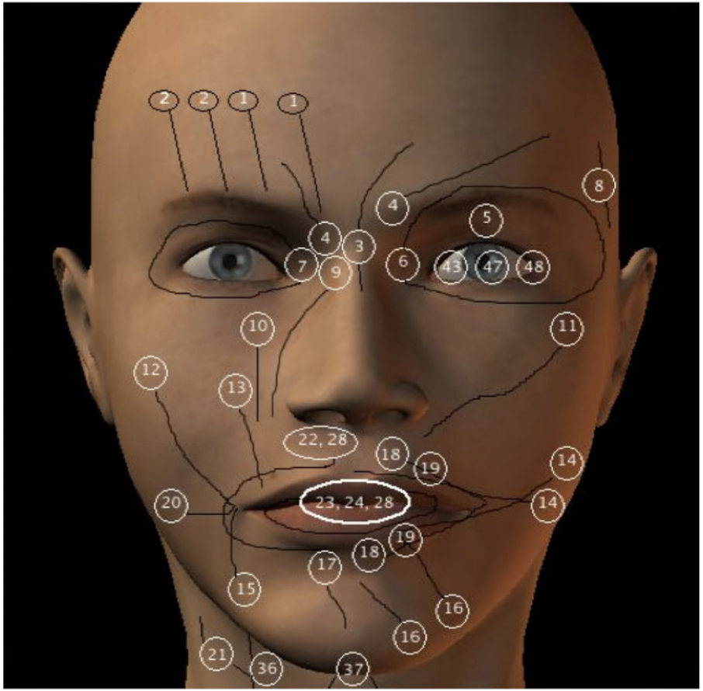
Other Databases
F-M FACS 3.0 (AU and Tongue Movements for Nomenclature)
Facial Expression | 6 basic + neutral + contempt, 3D technology, 8 AU and 22 TM for nomenclature
# of subjects | 10
# of image/video files | 4877
Image properties | Color at 3D 4k
Ground Truth (empirical evidence) | Facial expression labels & AU Intensity
Database Type | Deliberate (Posed) and Spontaneous

Slide 13
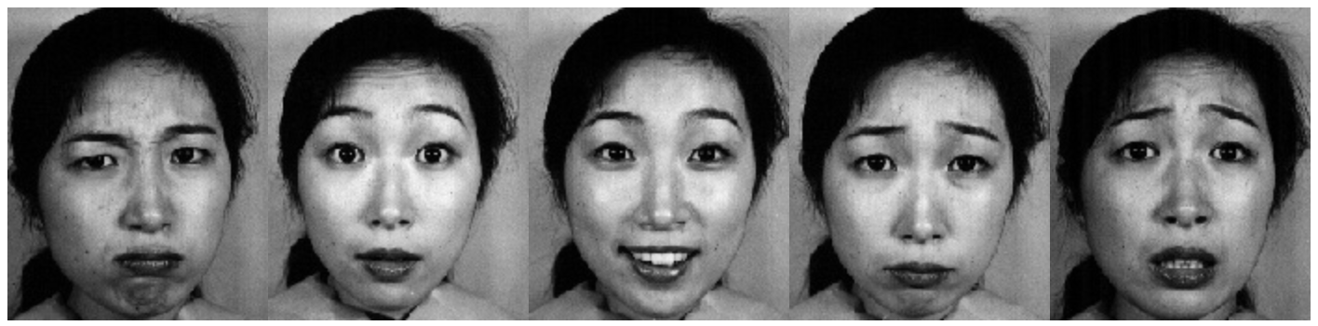
Other Databases
JAFFE (Japanese Female Facial Expressions) (1998)
Facial Expression | 6 basic + neutral
# of subjects | 10
# of image/video files | 213 static images
Image properties | Gray at 256x256
Ground Truth (empirical evidence) | Facial expression labels
Database Type | Deliberate (Posed)
http://www.kasrl.org/fg98-1.pdf

Slide 14
Other Databases
Belfast Naturalistic (2003)
A clip showing them in a state judged relatively emotional, and another judged relatively neutral
Facial Expression | 3 sets (disgust, fear, amusement / frustration, surprise / anger, sadness)
# of subjects | 60/82/114
# of image/video files | 1400 video clips
Image properties | Color
Ground Truth (empirical evidence) | n/a
Database Type | “Natural Emotion”
https://www.behance.net/gallery/10675283/Facial-Expression-Public-Databases

Slide 15
Other Databases
AffectNet (2017)
Collected via the Internet querying 1250 emotion related keywords
Facial Expression | 6 basic + neutral + contempt
# of subjects | ?
# of image/video files | ~1 million, half were manually annotated
Image properties | Color
Ground Truth (empirical evidence) | Emotion Labels with Valence/Arousal
Database Type | “Wild Setting”
http://mohammadmahoor.com/affectnet/

Slide 16
Other Databases
AFF-Wild (2011-2012?)
15 hours of video data for analysis of continuous emotion dimensions. Main source was Youtube
Facial Expression | ?
# of subjects | 200
# of image/video files | ~1.25 million manually annotated
Image properties | Color
Ground Truth (empirical evidence) | Valence/Arousal
Database Type | “Wild Setting”
https://ibug.doc.ic.ac.uk/resources/first-affect-wild-challenge/

Slide 17
Other Databases
SEMAINE Database (2012)
A major drive and future goal in HCI is to allow a human to speak to a machine as if they were speaking to another person
There is a need to capture non-verbal cues that exist in human conversation
e.g. turn-taking
DB consists of conversations between a human and a human operator who pretends to be an artificially intelligent agent with a prototypic emotional behavior. Each operator tries to pull the human into their respective emotional categories.
https://ibug.doc.ic.ac.uk/research/semaine-database/

Slide 18
Activity!
Kanade et. al devoted a section of their paper to discussing deliberate (posed) vs spontaneous expressions, but the majority of modern datasets today consist of posed expressions. Argue for & against these typed datasets.
Each side makes 1 statement pro their type
The other side argues against that point
A controversial topic for another time: In the same facial expression dataset, would you include both normal and clinically-impaired participants, as Kanade mentions at the end of section 2.5?

Slide 19
That’s all folks!

